Slide 1
REAL-TIME LOAN MANAGEMENT SYSTEM USING SQL
Prepared by
- BRINDA BHANVADIA

Slide 2
INTRODUCTION
Definition: A Loan Management System is designed to manage and process loan applications, customer data, and repayments.
Purpose: To streamline the loan process, manage customer data, and ensure efficient tracking of loan statuses.
Importance: Enhances operational efficiency, reduces errors, and provides better financial oversight.

Slide 3
TABLE OF CONTENTS
01
02
03
CUSTOMER INCOME STATUS
LOAN STATUS
CUSTOMER INFO
04
05
06
COUNTRY STATE
REGION INFO
CUSTOMER INCOME ANALYSIS
(Derived Table)

Slide 4
DATABASE DESIGN
Tables and Relationships: Defines how data is organized and linked.
Loan Status: Stores loan details (ID, amount, Cibil Score).
Customer Info: Stores customer information (ID, name, contact details).
Customer Income Status: Tracks repayment details (ID, loan Status, Income, Property)
Country state: Stores details of Customer’s State (State, Segment, Postal Code).
Region Info: Stores details of Region (ID, Region name)
Normalization: Process to ensure the database is free of redundancy and dependencies.

Slide 5
01 CUSTOMER INCOME STATUS

Slide 6
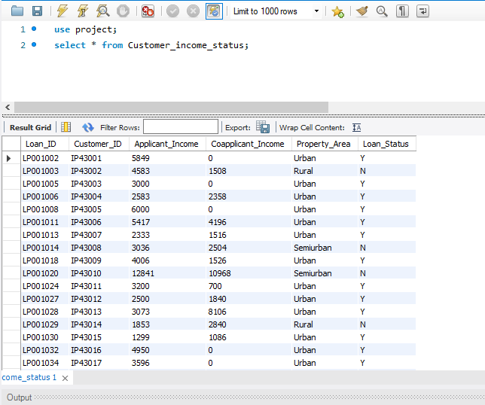
Import table Customer Income Status

Slide 7
Set customer criteria based on applicant income
Criteria
Applicant income >15,000 = grade a
Applicant income >9,000 = grade b
Applicant income >5000 = middle class customer
Otherwise low class
(Create this as new table)
Monthly interest percentage
Applicant income <5000 rural=3%
Applicant income <5000 semi rural=3.5%
Applicant income <5000 urban=5%
Applicant income <5000 semi urban= 2.5%
Otherwise =7%

Slide 8
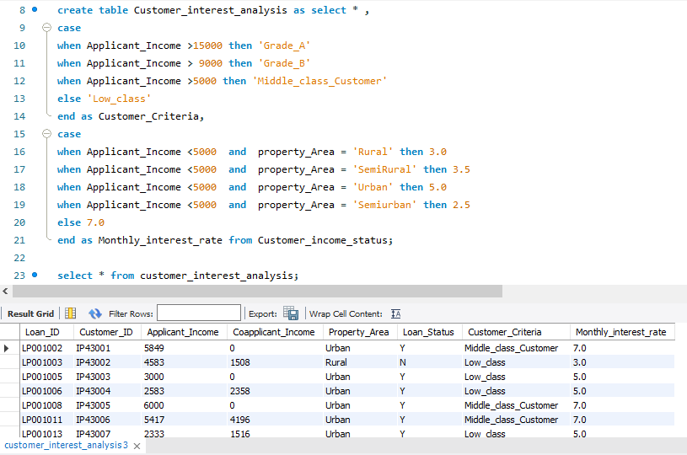

Slide 9
02 LOAN STATUS

Slide 10
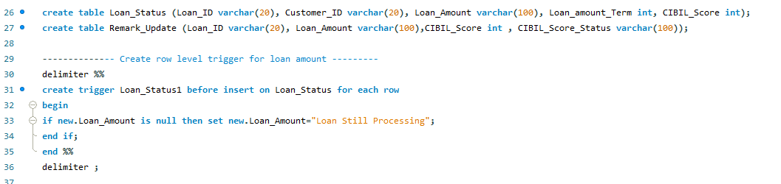
Create row level trigger for loan amount

Slide 11
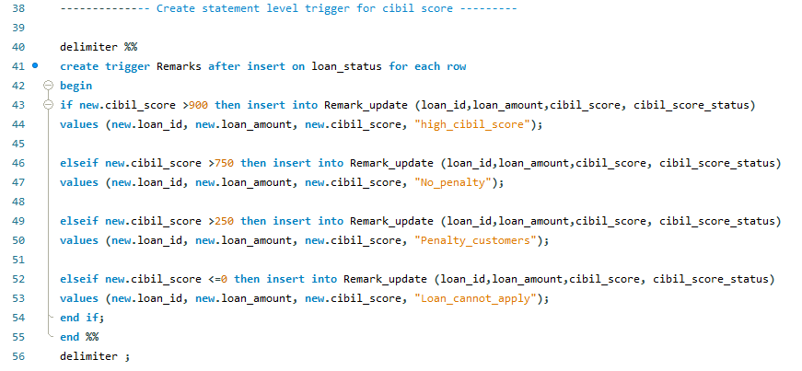
Create statement level trigger for cibil score

Slide 12
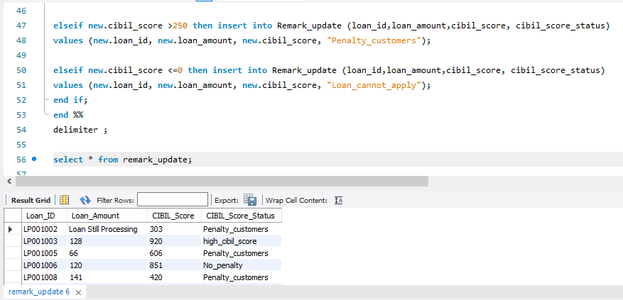
Criteria
Cibil score >900 high cibil score
Cibil score >750 no penalty
Cibil score >250 penalty customers
Cibil score <=0 reject customers (loan cannot apply)

Slide 13
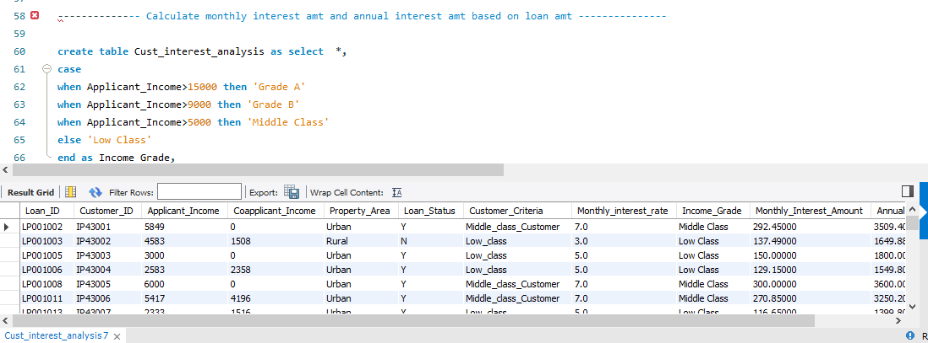
New field creation based on interest
Calculate monthly interest amount and annual interest amount based on loan amount
Create all the above fields as a table (Table name - customer interest analysis)

Slide 14
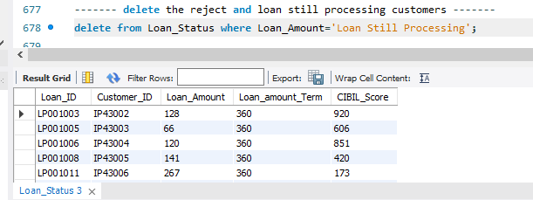
Delete the loan still processing customers

Slide 15
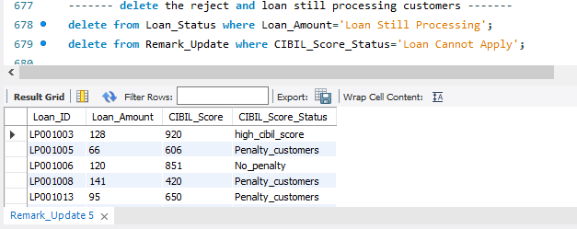
Delete the reject customers

Slide 16

Update loan as integers

Slide 17
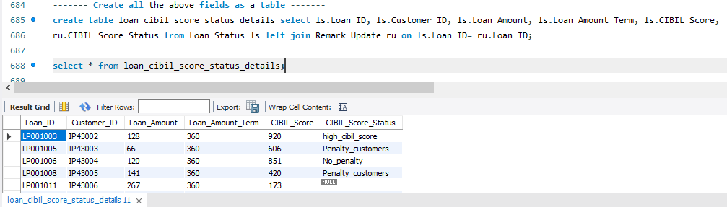
Create all the above fields as a table (loan cibil score status details)

Slide 18
03 CUSTOMER INFO

Slide 19
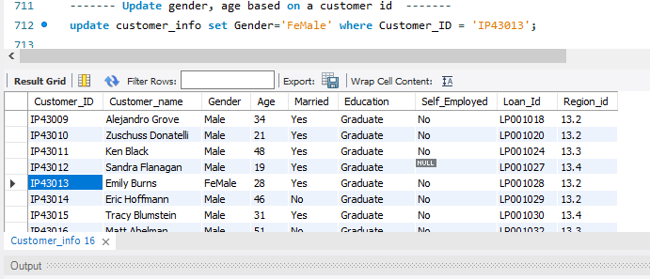
Update gender and age based on customer id

Slide 20
04 COUNTRY STATE
05
REGION INFO

Slide 21
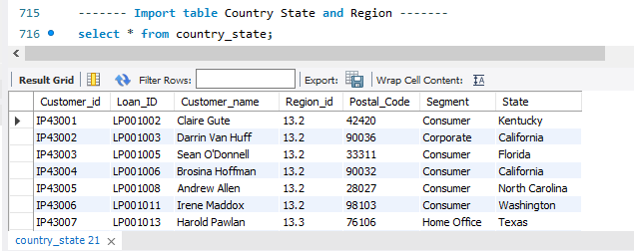
Import the table Country State

Slide 22
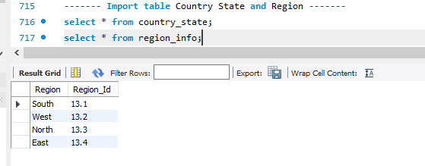
Import the table Region Info

Slide 23
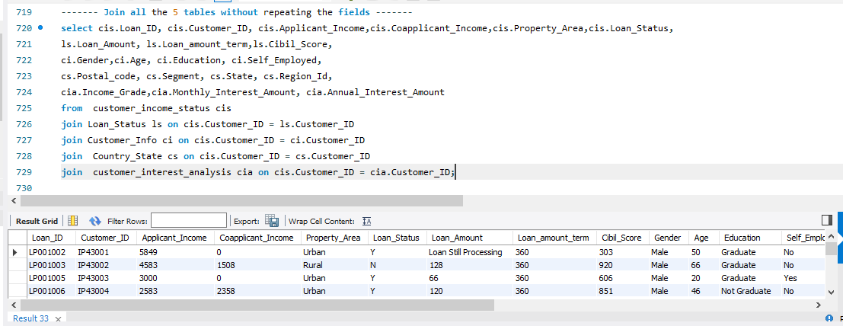
Join all the 5 tables without repeating Fields

Slide 24
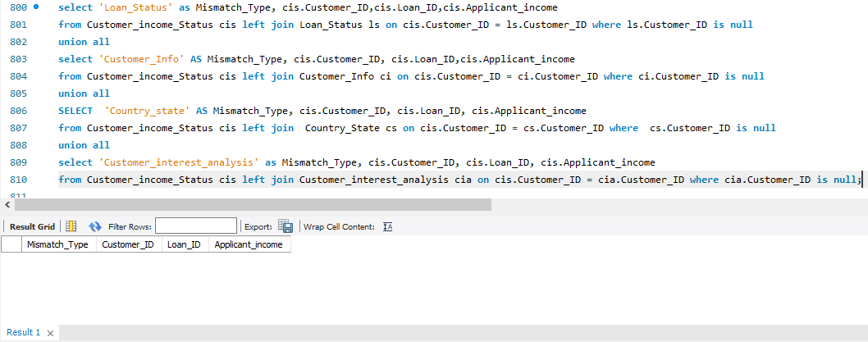
Find the mismatch details using joins

Slide 25
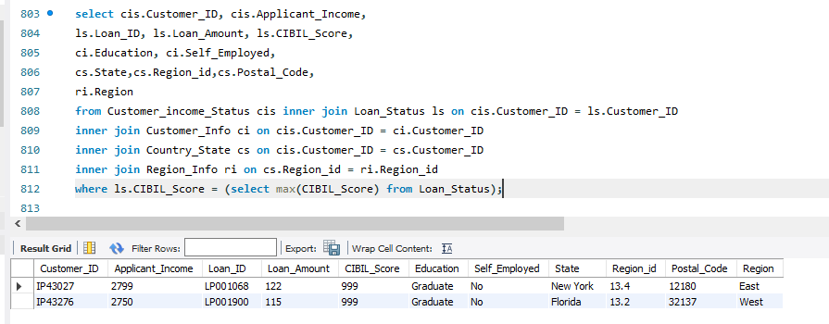
Filtering information using inner join Filter high cibil score

Slide 26
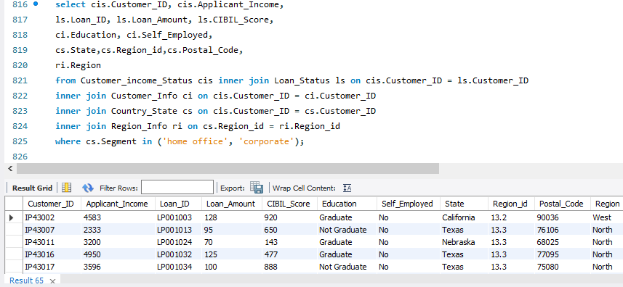
Filtering information using inner join Filter home office and corporate

Slide 27
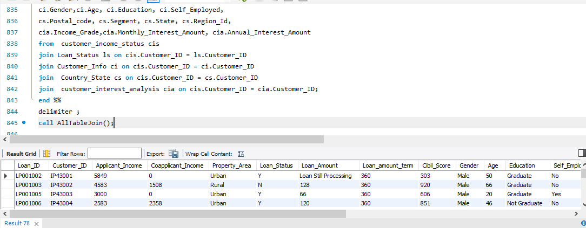
Filtering information using inner join Store all the outputs as procedure

Slide 28
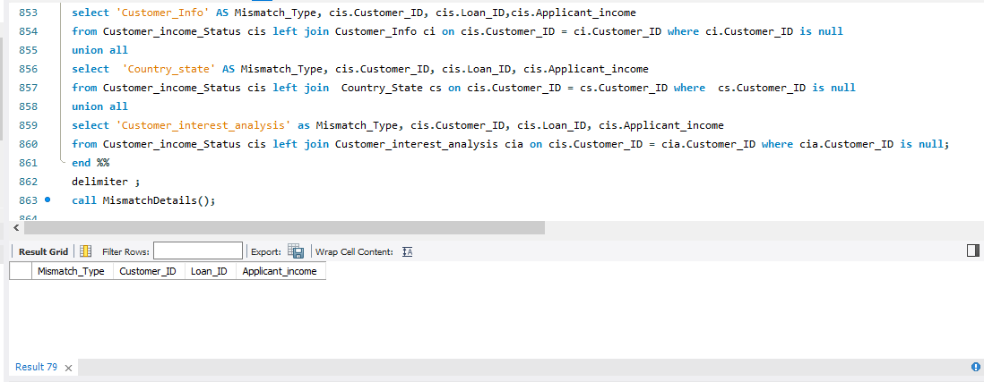
Filtering information using inner join Store all the outputs as procedure

Slide 29
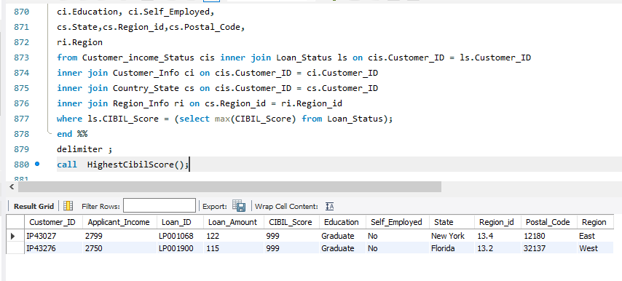
Filtering information using inner join Store all the outputs as procedure

Slide 30
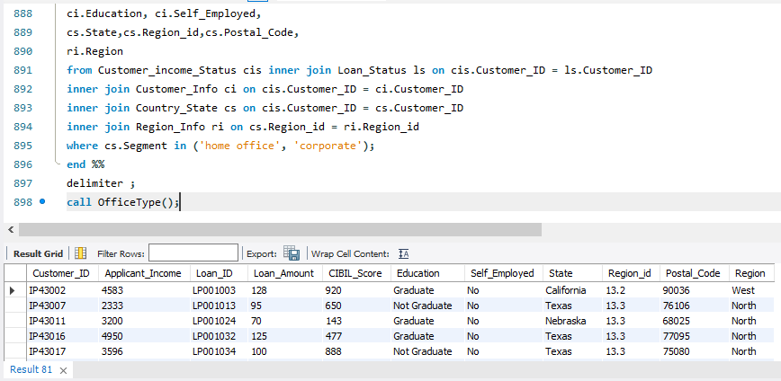
Filtering information using inner join Store all the outputs as procedure

Slide 31
PERFORMANCE OPTIMIZATION
Indexing: Improves query performance by creating indexes on frequently queried columns.
Query Optimization: Techniques like avoiding unnecessary joins and using efficient queries.
Handling Large Datasets: Strategies for managing and querying large volumes of data.

Slide 32
FUTURE ENHANCEMENT
Potential Improvements: Integration with other financial systems, implementing machine learning for credit scoring.
Technological Advancements: Adoption of cloud databases, advanced analytics.

Slide 33
CONCLUSION
Benefits of SQL in Loan Management System:
Efficient data management, robust querying capabilities.
.

Slide 34
CONNECT WITH ME HERE:
LINKEDIN
GITHUB
www.linkedin.com/in/brindabhanvdia1805
https://github.com/brindabhanvadia
EMAIL
brinda1805@gmail.com

Slide 35
PROJECT BY
BESANT TECHNOLOGIES
ANNA NAGAR, CHENNAI

Slide 36
THANK YOU

